Slide 1
Data Spark – illuminating insights for global electronics

Slide 2
Objective
Conducting a comprehensive Exploratory Data Analysis (EDA) to uncover valuable insights from the company’s data.
Your goal is to provide actionable recommendations that can enhance customer satisfaction, optimize operations, and drive overall business growth.

Slide 3
Steps followed
Data extraction : Data is downloaded from the given drive as a csv file.
Data cleaning : All the data is then loaded in the .ipynb file using pandas.
Null values
Duplication
Inconsistencies
Merging the table using the primary keys in each table
Storing into Database: Using sqlalchemy, Data is been stored to MySQL.
MySQL Workbench: Queries is been written in the script to extract the necessary data as per the need.
PowerBI: The exported data is then imported into PowerBI for creating the necessary dashboards.

Slide 4
Recomendation
Customer analysis: Female are focused less when compared to the male customers. This focus needs to be improved.
Stores Analysis: Online stores is showing the highest record in total sales. This can be encouraged by introducing the memberships, advertisements, referall programmes etc.,
Product analysis: computer category is the most selling category and least selling is TV and Video. So TV and Video can be focused more on selling like usage of promotions etc.,
Sales are very high in the month of December and February. So things needs to be procured more for selling during those months.

Slide 5
Analysis – Dashboard Powerbi

Slide 6
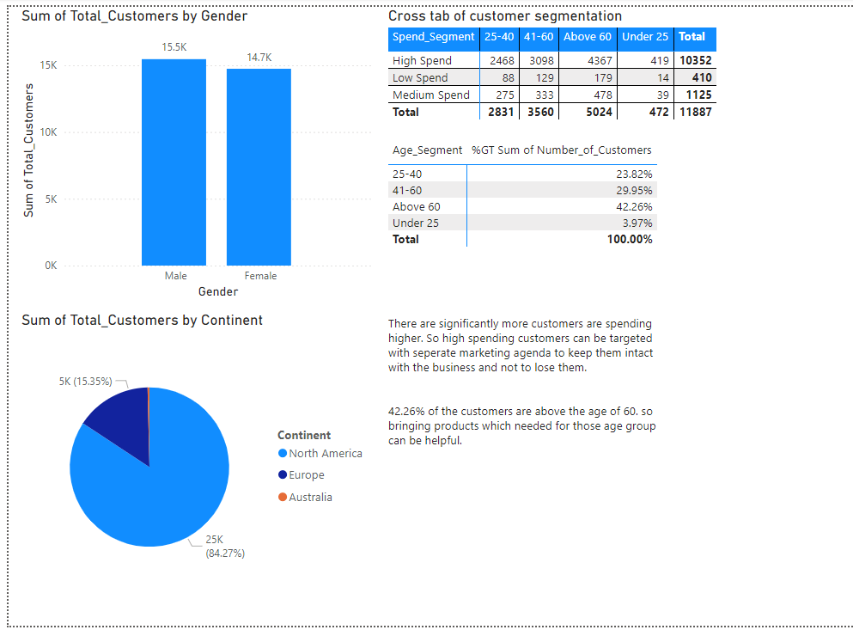

Slide 7
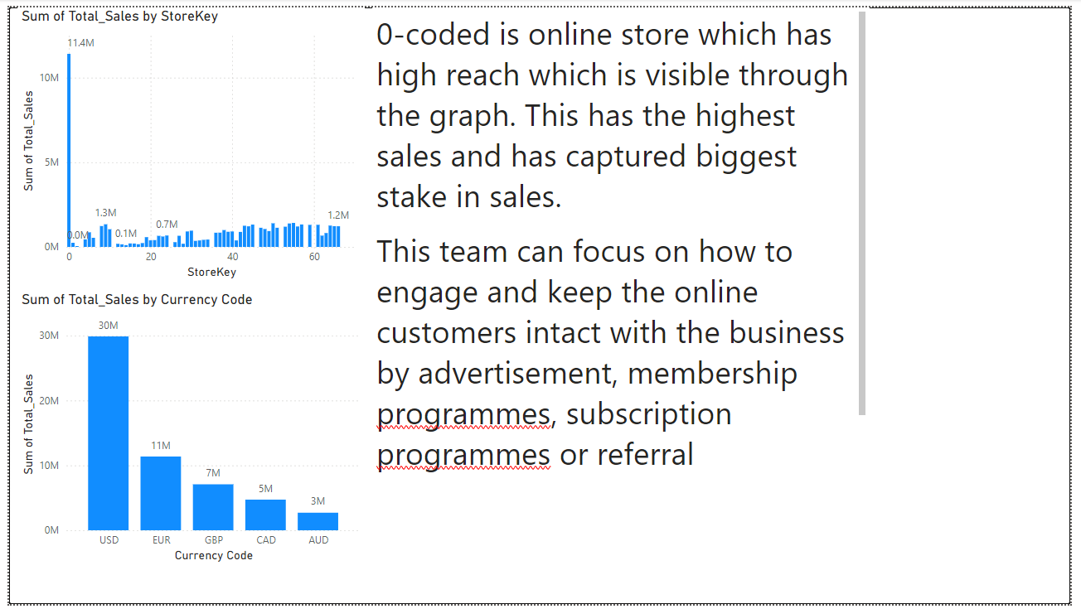

Slide 8
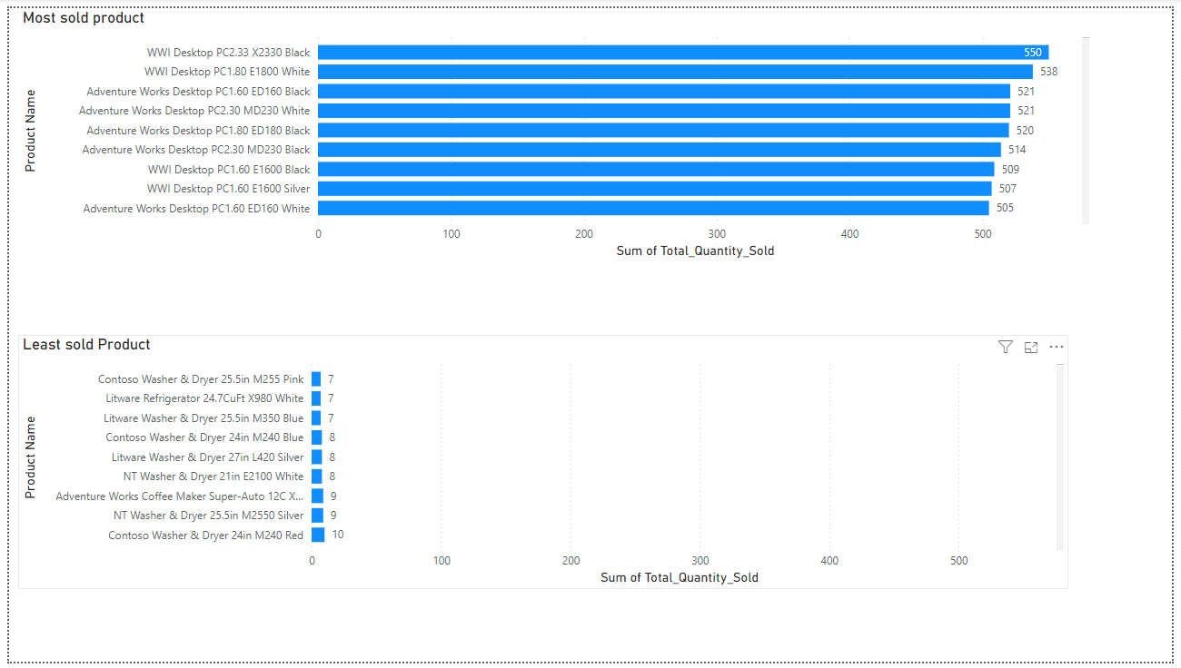

Slide 9
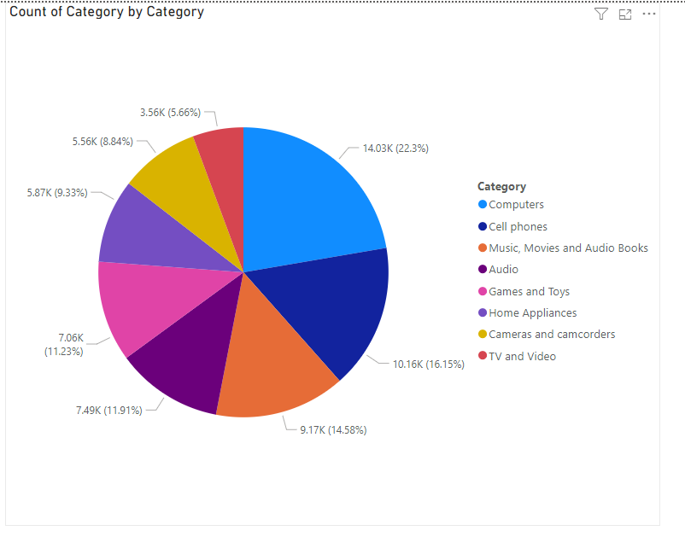

Slide 10
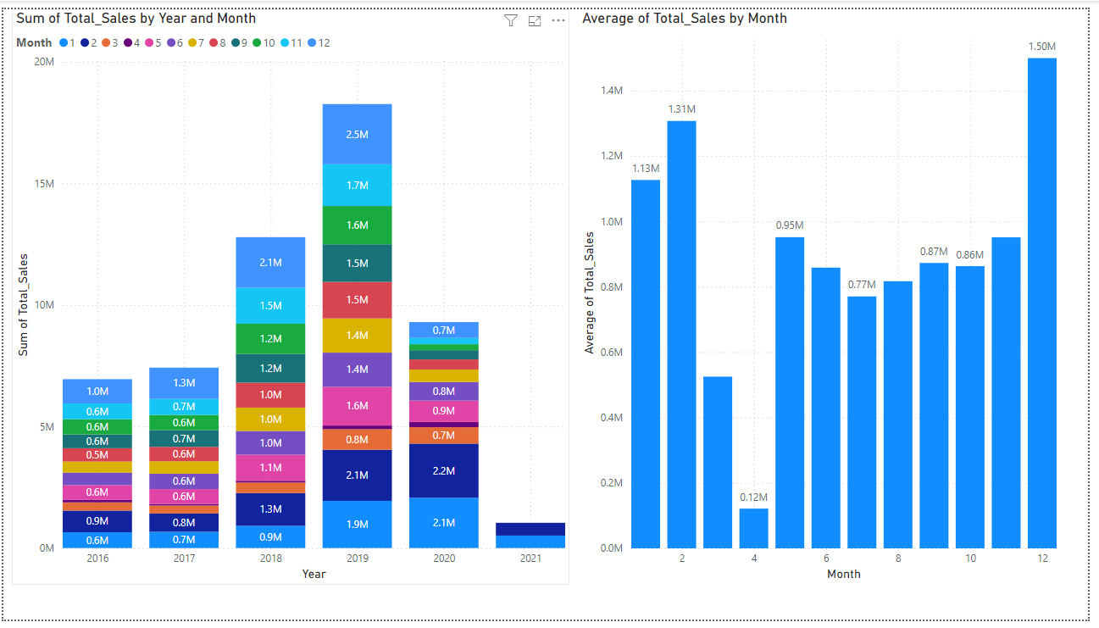

Slide 11

Thank you
Saravana Kumar T
Github: https://github.com/saromaddy/Data_spark_guvi.git

